Slide 1


Apache Kylin
&
Zeppelin Integration
Luke Han & Jason Zhong
http://kylin.io | @ApacheKylin

Slide 2
About Us
Luke Han (@lukehq)
Product Lead of Analytics Data Infrastructure, eBay
Co-creator, Committer & PMC Member of Apache Kylin
Jason Zhong
Software developer of ADI, eBay
Committer & PMC Member of Apache Kylin

Slide 3
Agenda
About Apache Kylin
Feature Highlights
Tech Highlights
Zeppelin Integration
Roadmap
Q&A

Slide 4


What
kylin / ˈkiːˈlɪn / 麒麟
--n. (in Chinese art) a mythical animal of composite form
@ApacheKylin
Extreme OLAP Engine for Big Data
Kylin is an open source Distributed Analytics Engine, contributed by eBay Inc., provides SQL interface and multi-dimensional analysis (OLAP) on Hadoop supporting extremely large datasets
Open Sourced on Oct 1st, 2014
Accepted as Apache Incubator Project on Nov 25th, 2014
http://kylin.io (http://kylin.incubator.apache.org)

Slide 5

About Kylin
Kylin Site:
http://kylin.io
Twitter/微博:
@ApacheKylin
微信公众号：
ApacheKylin

Slide 6
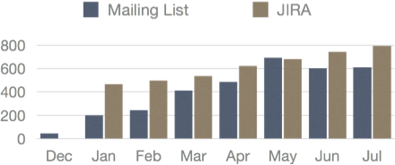
Who are using Kylin?
External
25+ contributors in community
Adoption:
On Production: Baidu Map
Evaluation: Huawei, VIPShop, Meituan, Bloomberg Law, British Gas, JD.com, Microsoft, Tableau…
eBay Internal Cases
90% ile query < 3 seconds
—from mailing list
Case | Cube Size | Raw Records
User Session Analysis | 14+TB | 75+ billion rows
Traffic Analysis | 21+ TB | 20+ billion rows
Behavior Analysis | 560+ GB | 1.2+ billion rows

Slide 7


Why
Happiness
size
10s
Latency

Slide 8
Business Needs for Big Data Analytics
Sub-second query latency on billions of rows
ANSI SQL for both analysts and engineers
Full OLAP capability to offer advanced functionality
Seamless Integration with BI Tools
Support of high cardinality and high dimensions
High concurrency – thousands of end users
Distributed and scale out architecture for large data volume

Slide 9
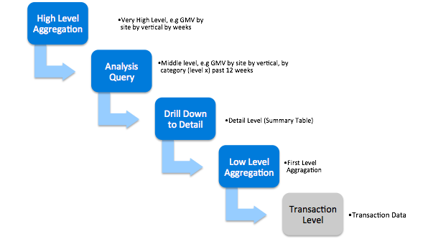
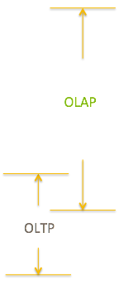
Analytics Query Taxonomy

Slide 10
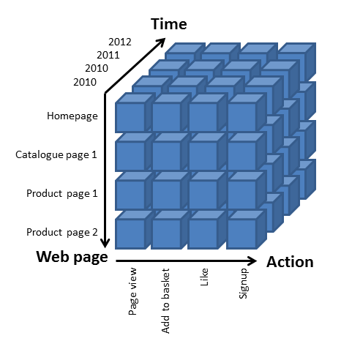
Balance Between Space and Time
0-D(apex) cuboid
OLAP Cube
time
item
location
supplier
1-D cuboids
Cuboid = one combination of dimensions
Cube = all combination of dimensions (all cuboids)
time, item
time, location
item, location
location, supplier
Time, supplier
item, supplier
2-D cuboids
time, location, supplier
3-D cuboids
time, item, location
time, item, supplier
item, location, supplier
time, item, location, supplier
4-D(base) cuboid
Base vs. aggregate cells; ancestor vs. descendant cells; parent vs. child cells
(9/15, milk, Urbana, Dairy_land) - <time, item, location, supplier>
(9/15, milk, Urbana, *) - <time, item, location>
(*, milk, Urbana, *) - <item, location>
(*, milk, Chicago, *) - <item, location>
(*, milk, *, *) - <item>

Slide 11
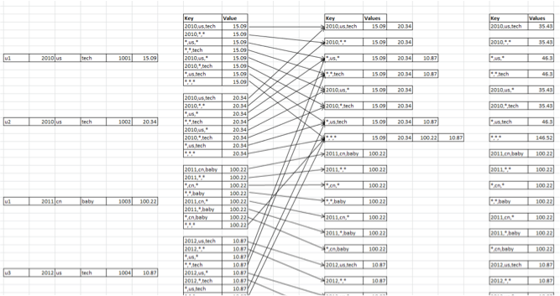
From Relational to Key-Value

Slide 12



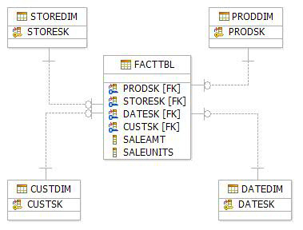





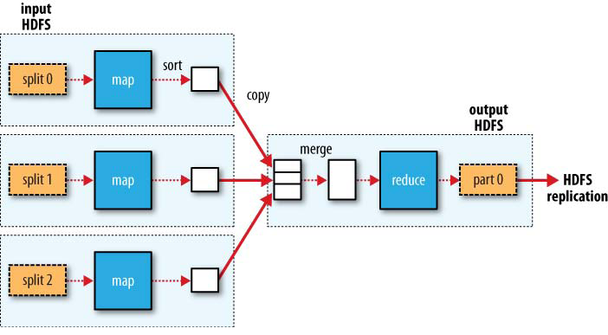
How
BI Tools, Web App…
ANSI SQL
Kylin
Map Reduce

Slide 13
Agenda
About Apache Kylin
Feature Highlights
Tech Highlights
Zeppelin Integration
Roadmap
Q&A

Slide 14
Feature Highlights
Extremely Fast OLAP Engine at scale
ANSI SQL Interface on Hadoop
Seamless Integration with BI Tools, like Tableau
Interactive Query Capability
Incremental Build of Cubes
Approximate Query Capability for Distinct Count (HyperLogLog)
Leverage HBase Coprocessor for query latency
Job Management and Monitoring
User friendly Web GUI for manage, build, monitor and query cubes
Zeppelin interpreter enabled
Security capability to set ACL at Cube/Project Level, support LDAP Integration
Streaming supported for Near Real-time
Kylin on Spark is on the way

Slide 15
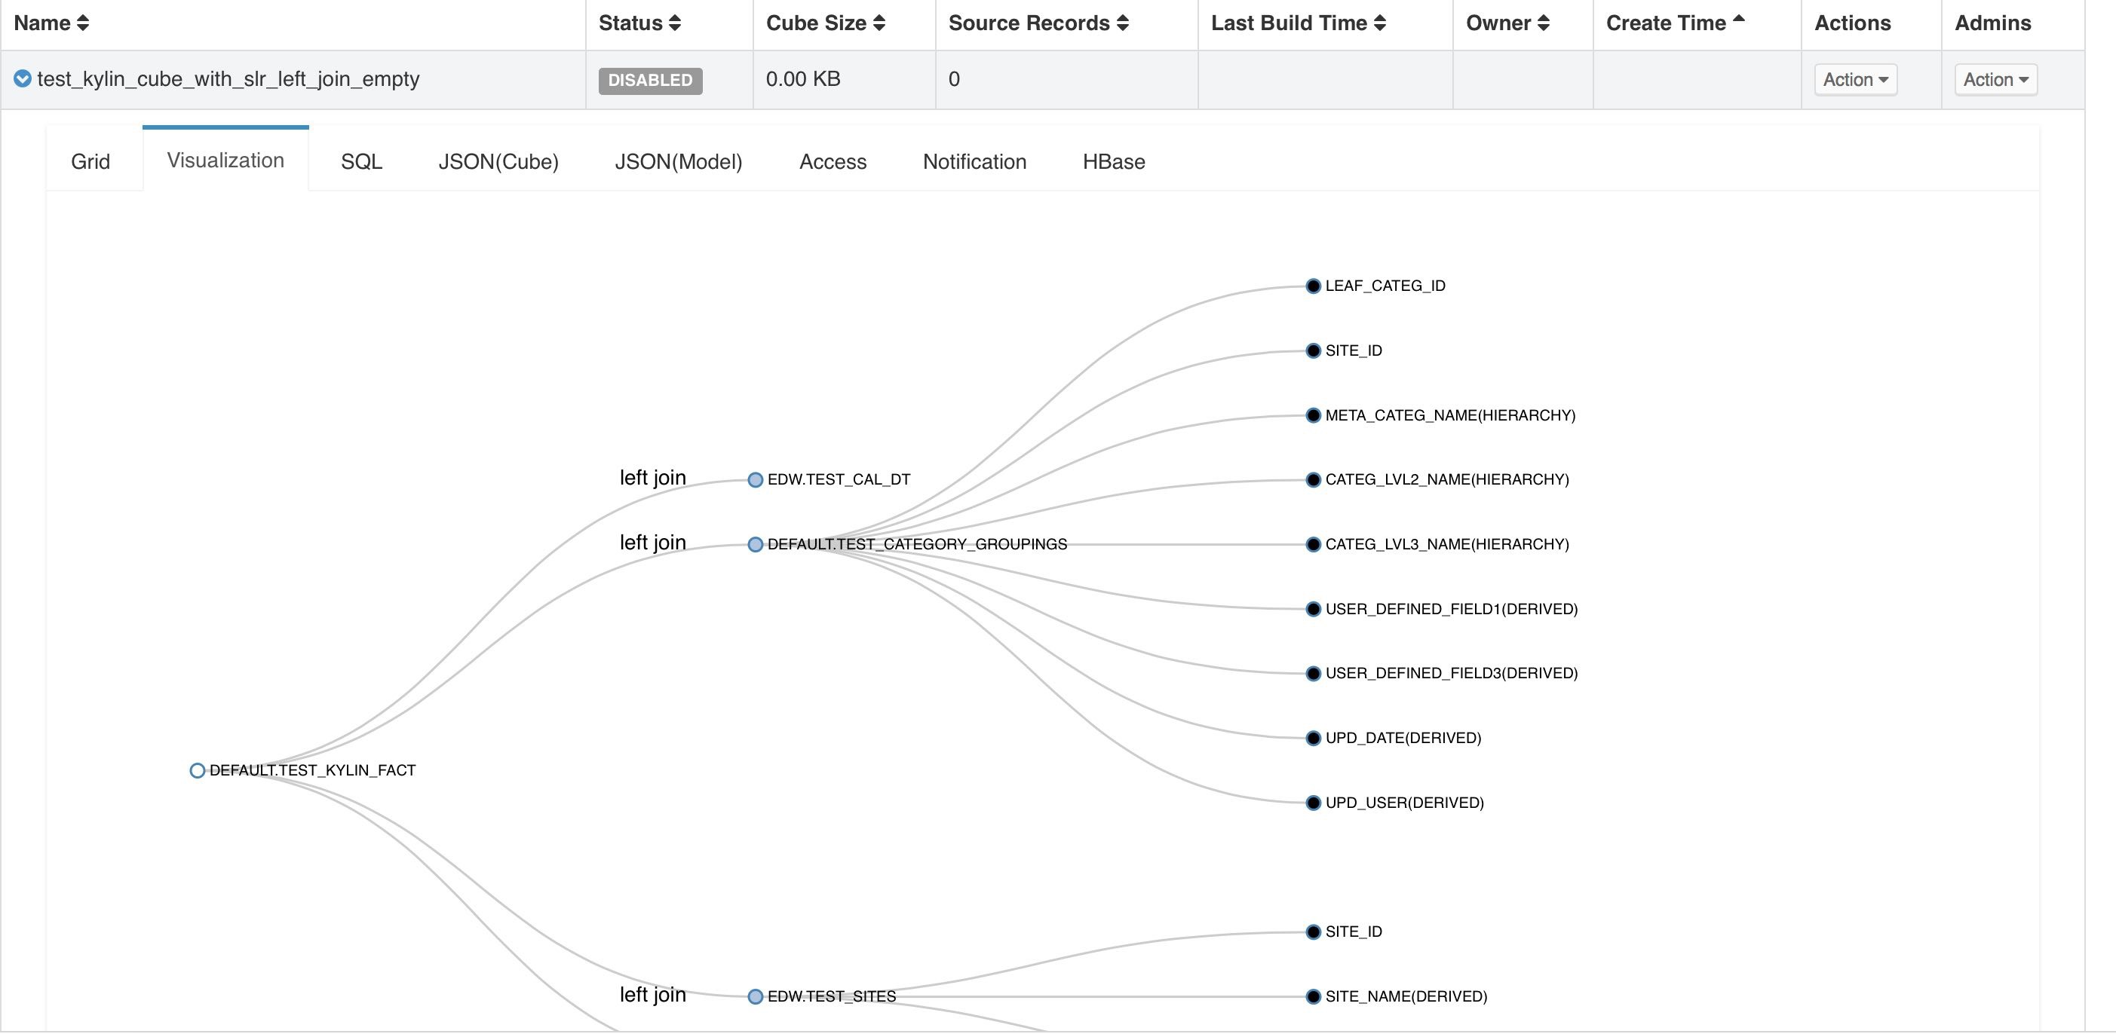
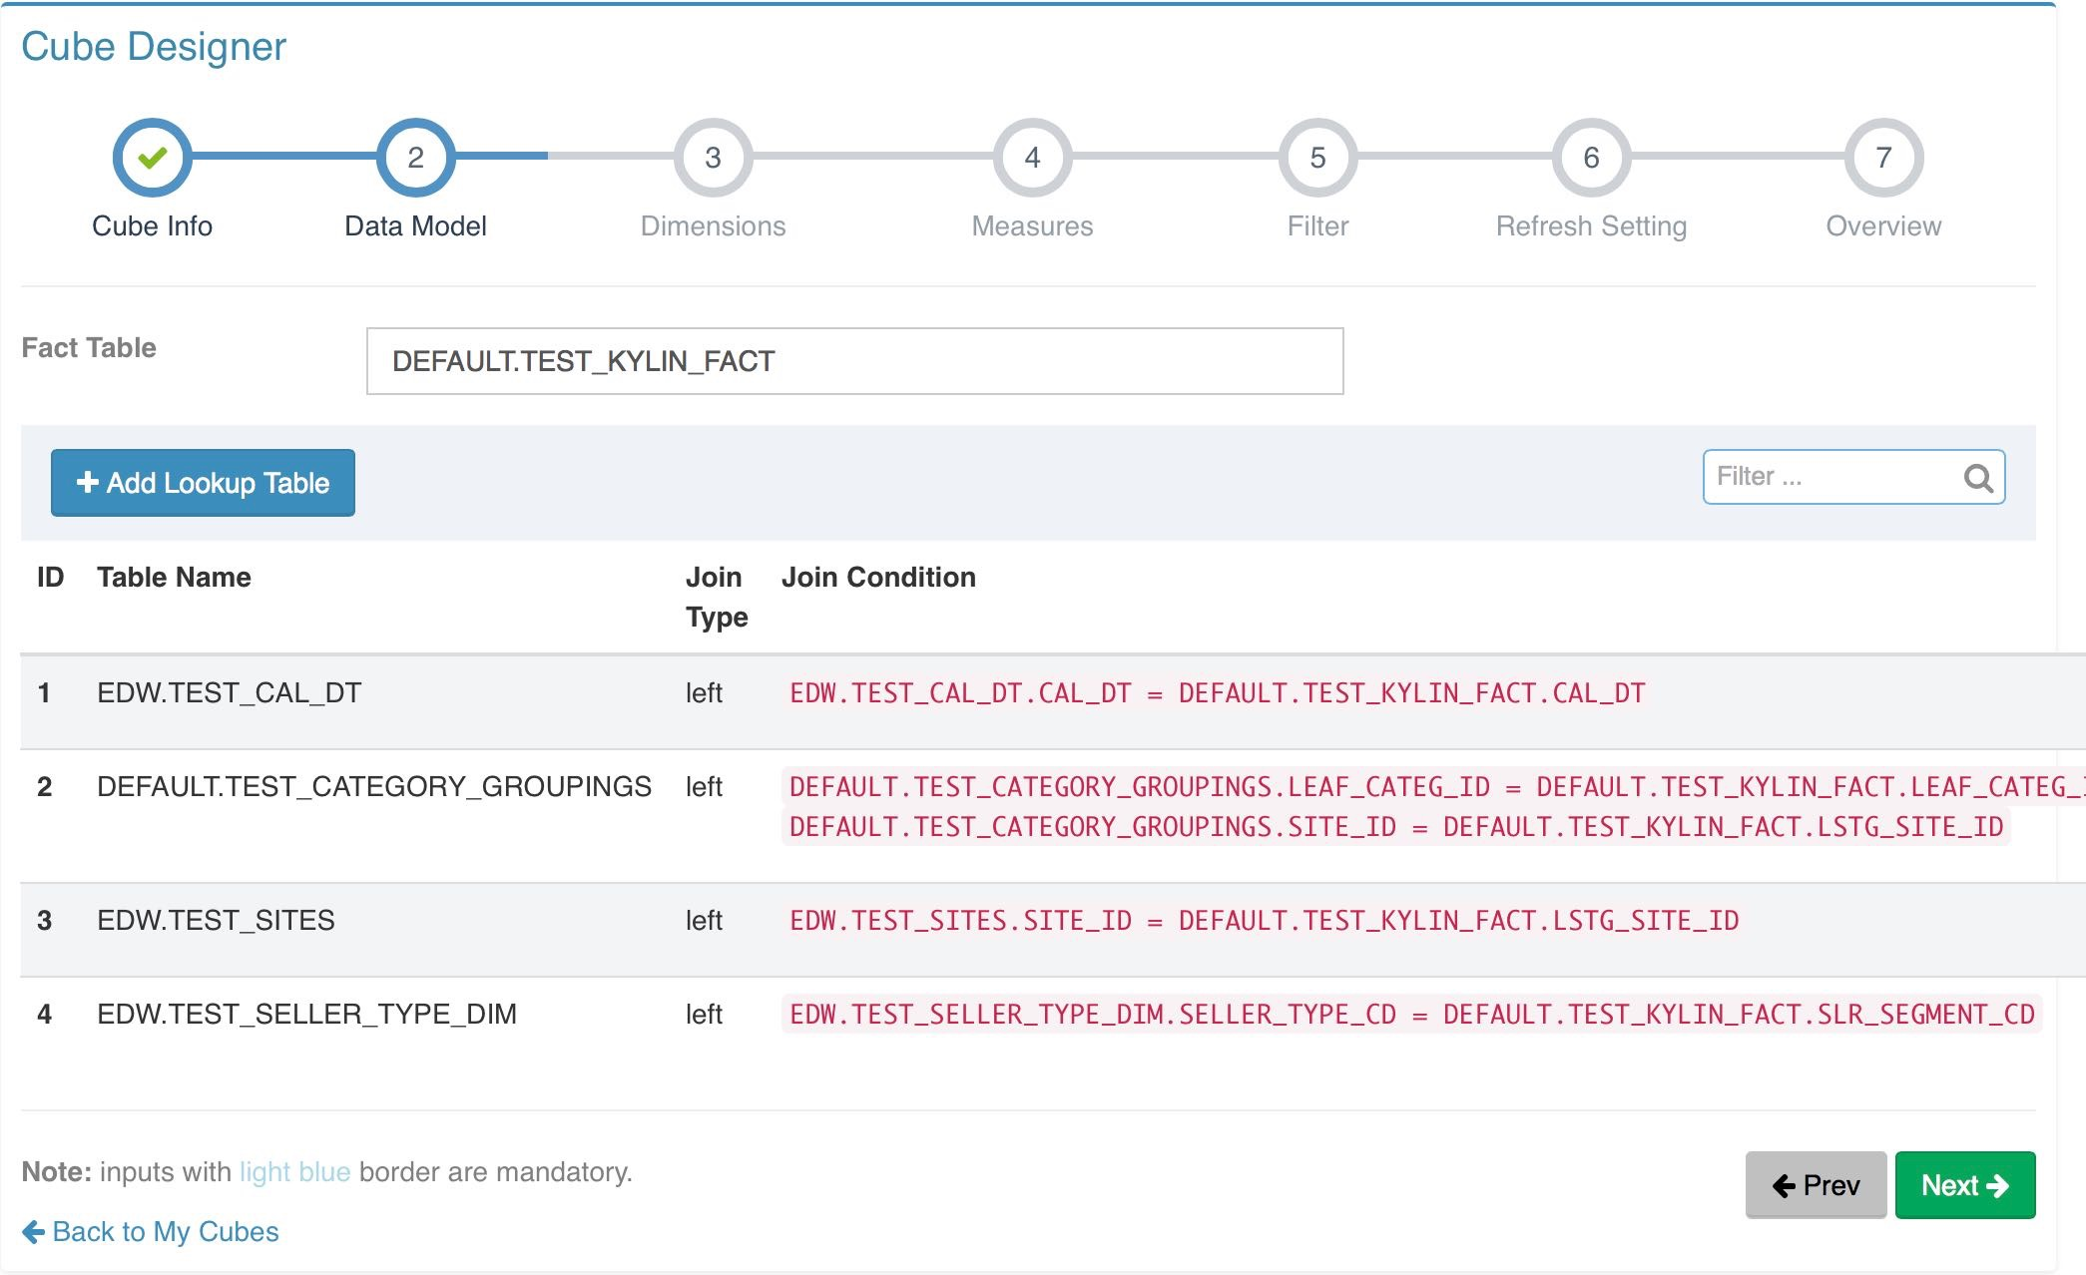
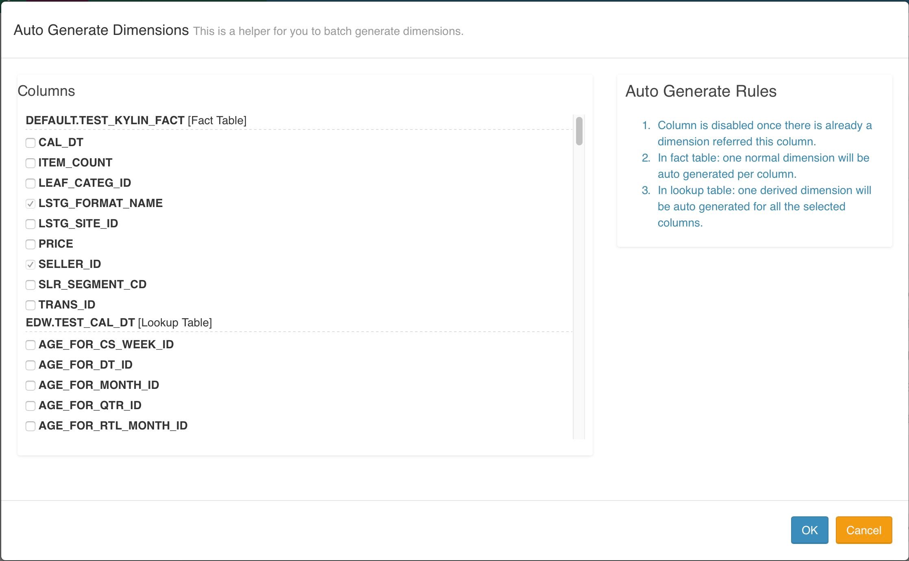
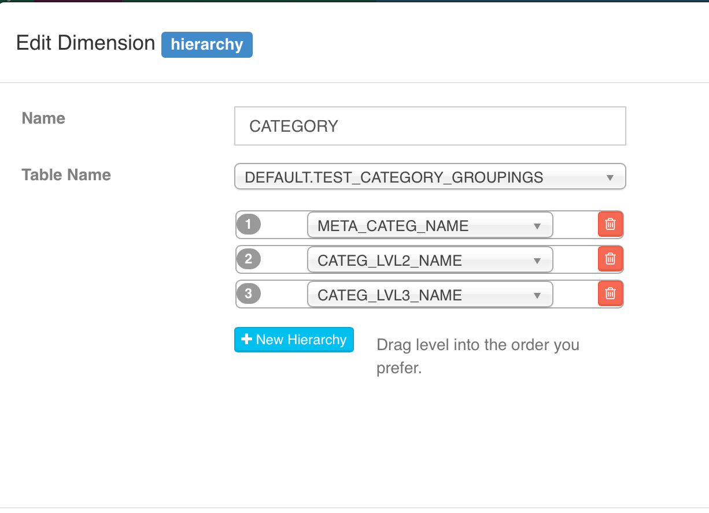
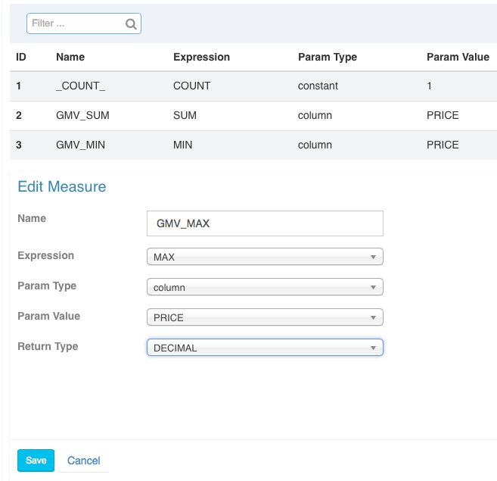
Define Data Model

Slide 16
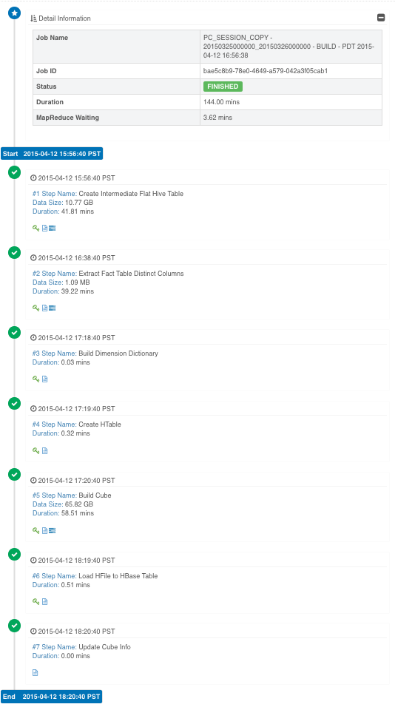
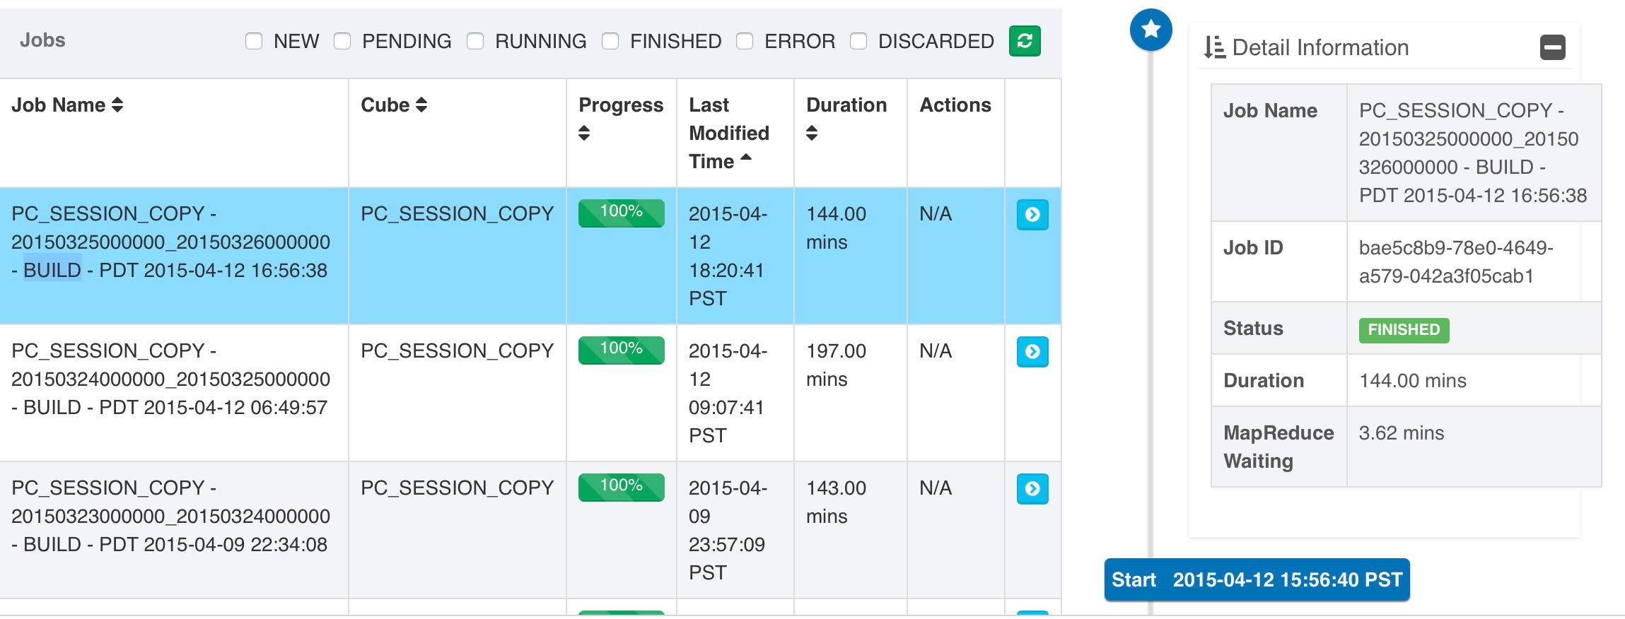
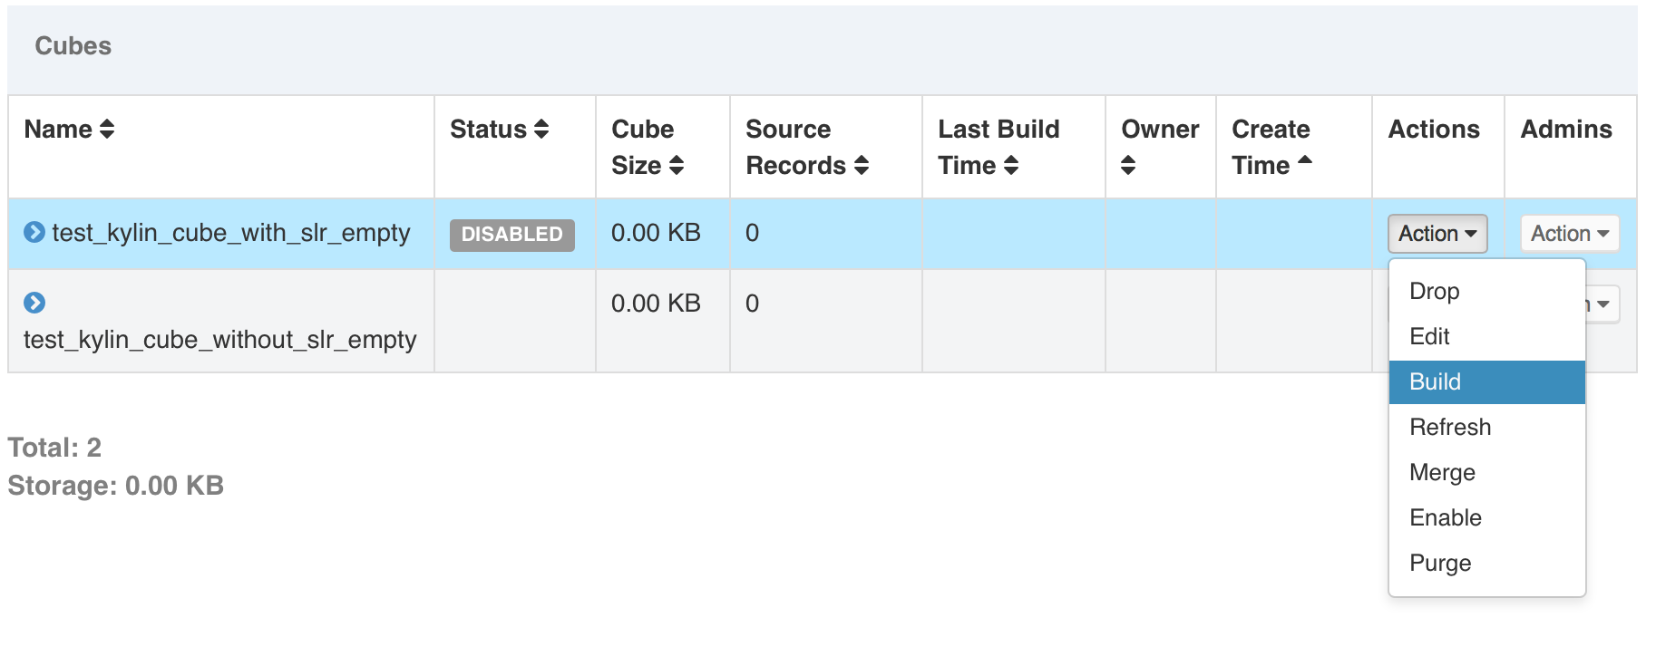
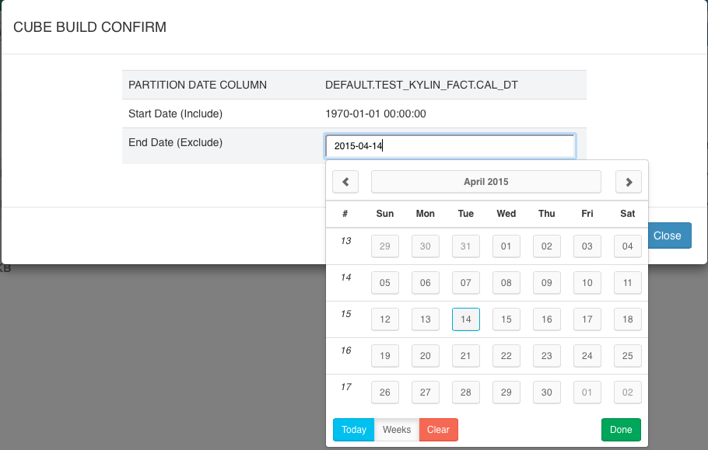
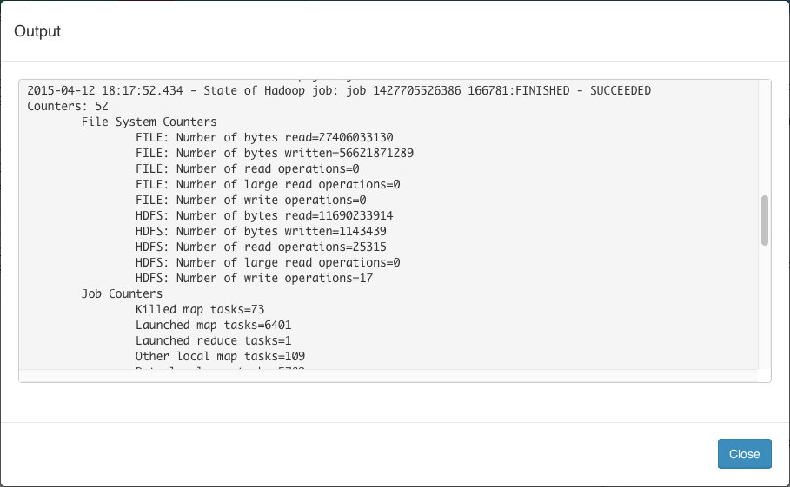
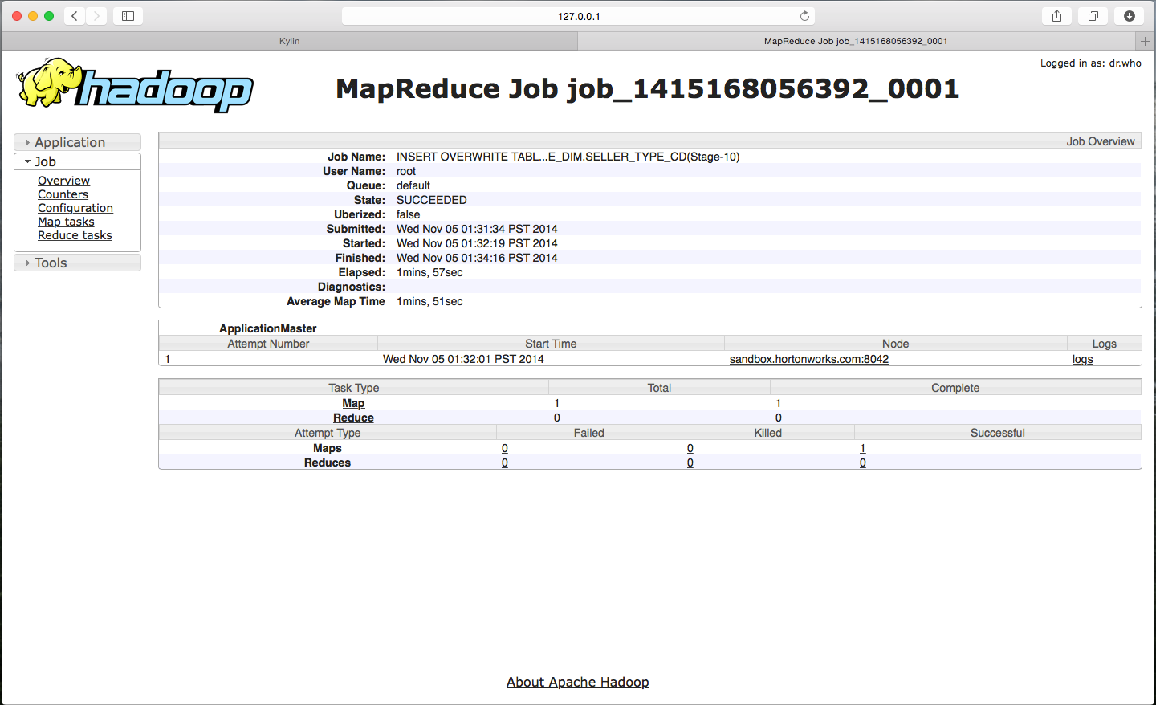
Manage Jobs

Slide 17
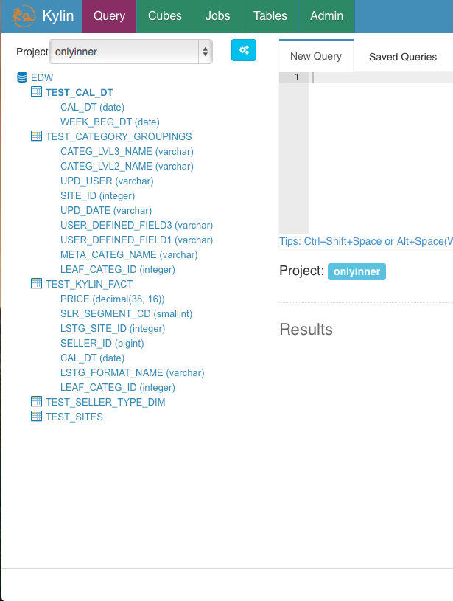
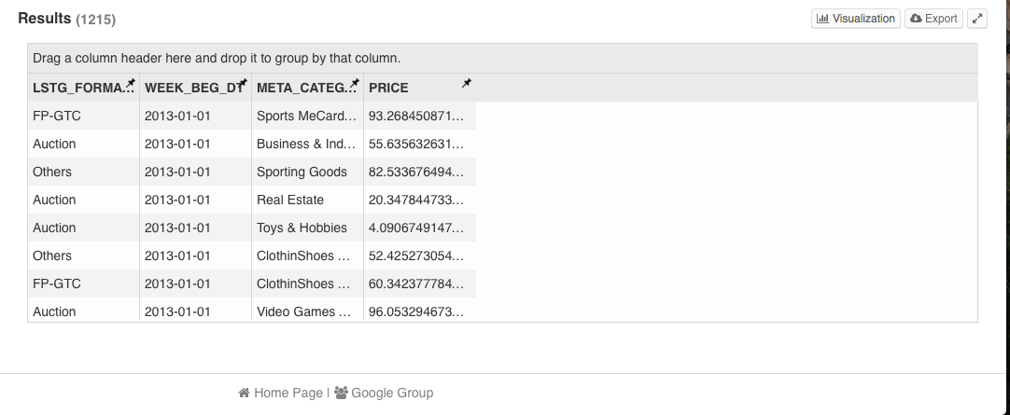
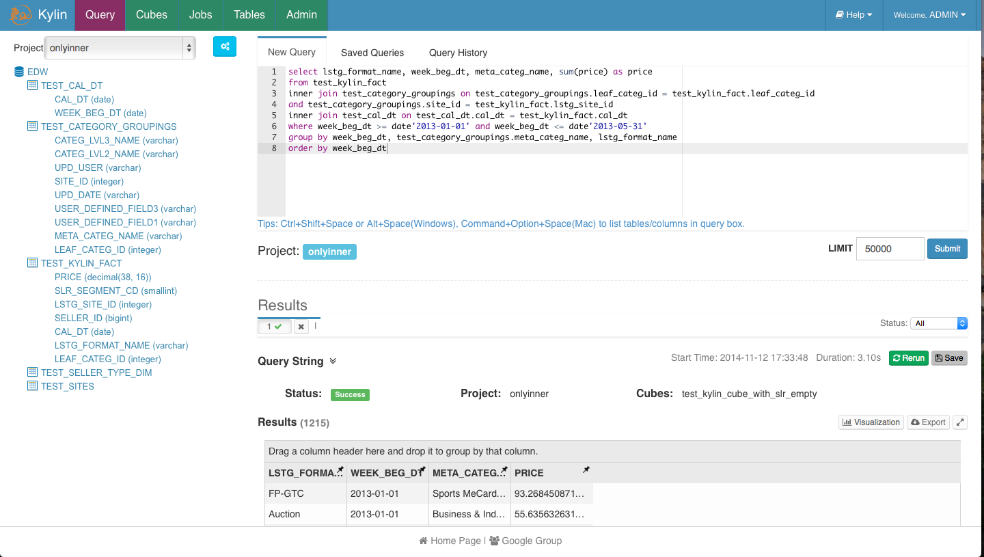
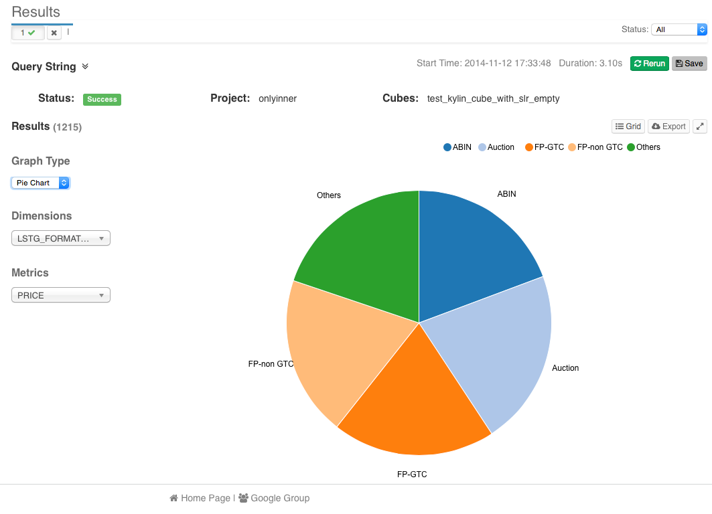
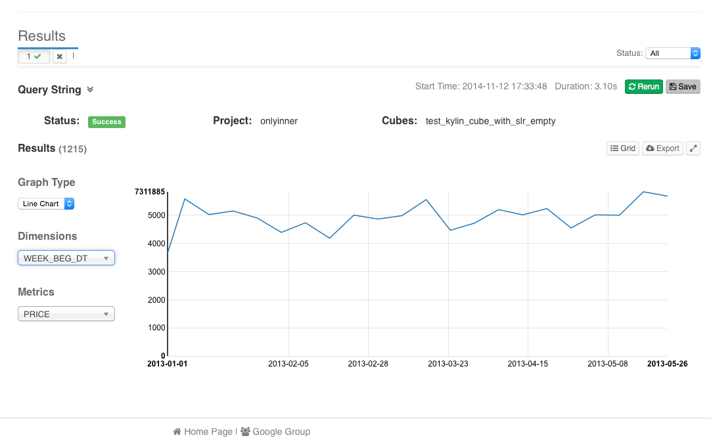
Explore the Data

Slide 18
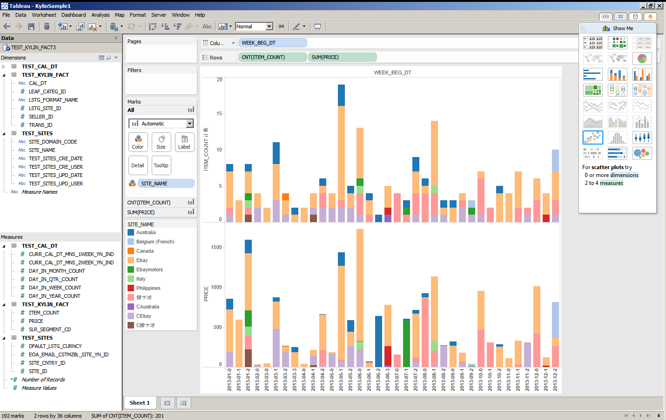
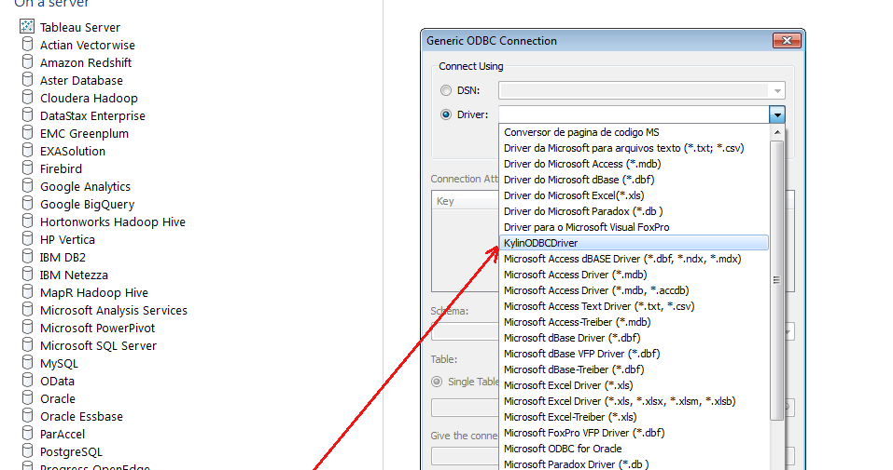
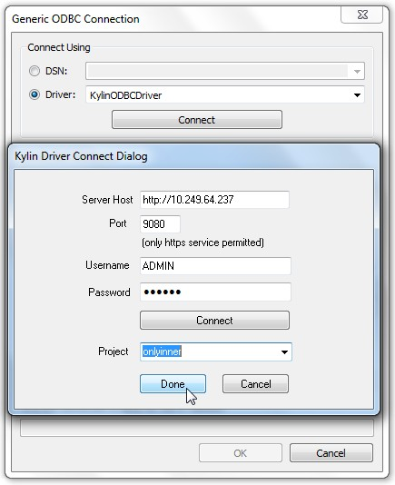
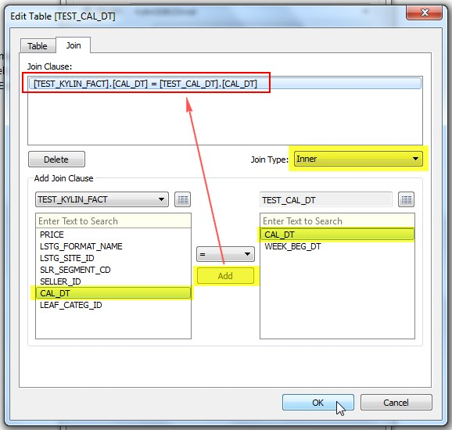
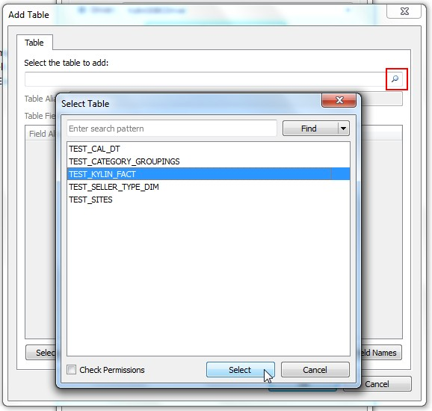
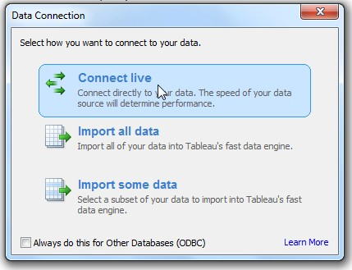
Interactive with BI Tool - Tableau

Slide 19
Agenda
About Apache Kylin
Feature Highlights
Tech Highlights
Zeppelin Integration
Roadmap
Q&A

Slide 20
Kylin Architecture Overview
3rd Party App
(Web App, Mobile…)
SQL-Based Tool
(BI Tools: Tableau…)
Online Analysis Data Flow
Offline Data Flow
Clients/Users interactive with Kylin via SQL
OLAP Cube is transparent to users
REST API
JDBC/ODBC
SQL
SQL
REST Server
Query Engine
Mid Latency - Minutes
Routing
Low Latency - Seconds
Hadoop
Hive
Data Cube
Metadata
OLAP
Cube
(HBase)
Cube Build Engine
(MapReduce…)
Star Schema Data
Key Value Data

Slide 21



Data Modeling
End User
Cube Modeler
Admin
Cube: …
Fact Table: …
Dimensions: …
Measures: …
Storage(HBase): …
Dim
Row Key
Column
row A
Val 1
row B
Val 2
Fact
row C
Val 3
Dim
Dim
Column Family
Source
Star Schema
Mapping
Cube Metadata
Target
HBase Storage

Slide 22
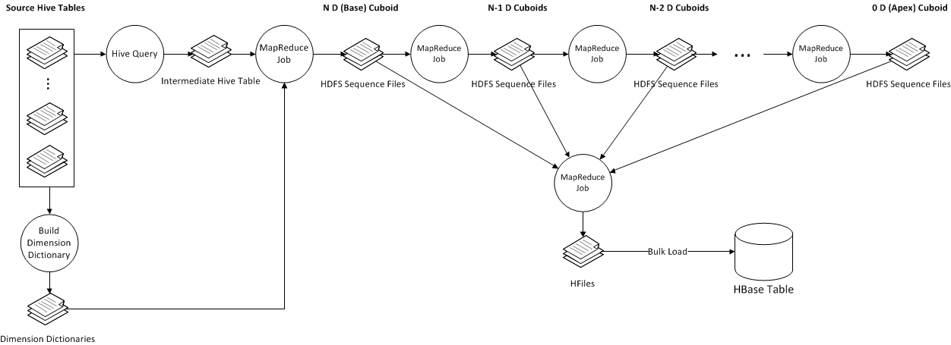
Cube Build Job Flow

Slide 23
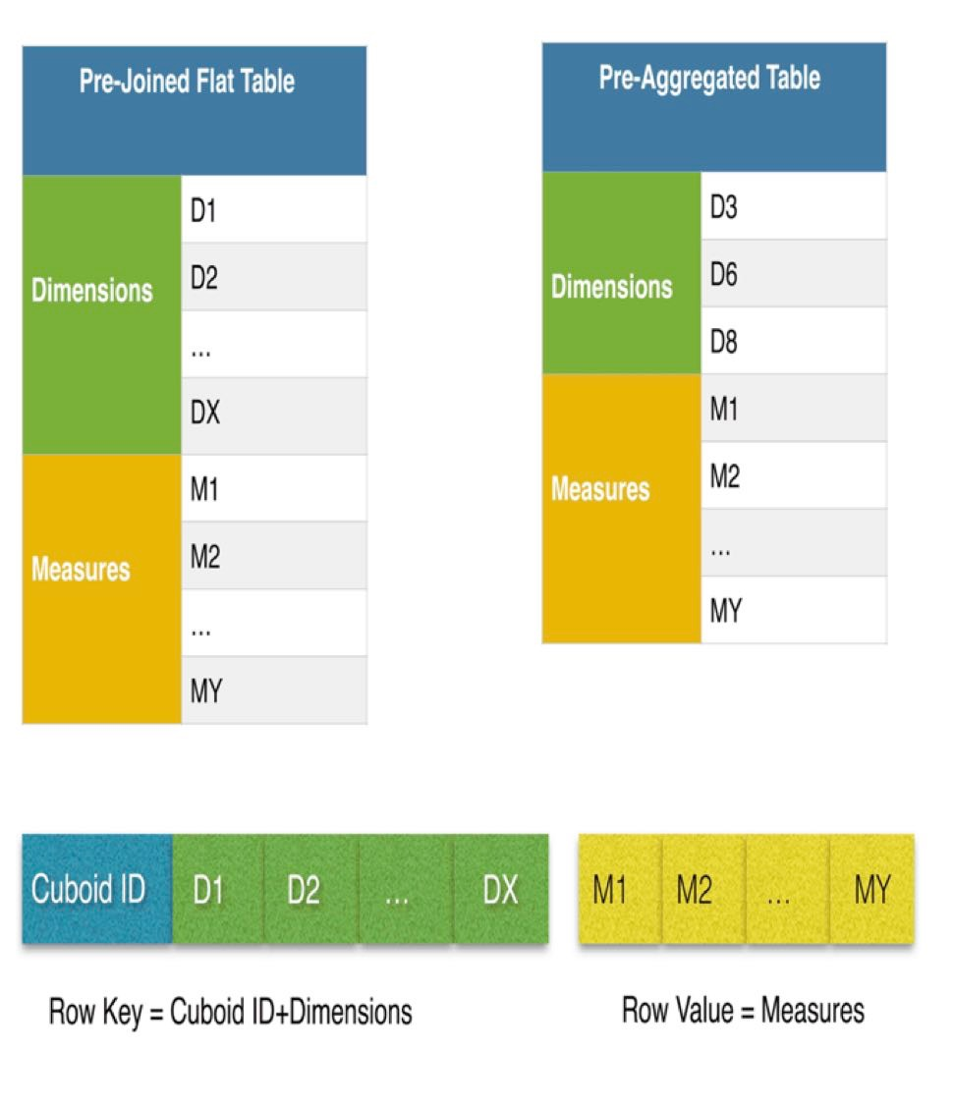

How to Store Cube - HBase Schema

Slide 24

Kylin Query Engine - Explain Plan
SELECT test_cal_dt.week_beg_dt, test_category.category_name, test_category.lvl2_name, test_category.lvl3_name, test_kylin_fact.lstg_format_name, test_sites.site_name, SUM(test_kylin_fact.price) AS GMV, COUNT(*) AS TRANS_CNT
FROM test_kylin_fact
LEFT JOIN test_cal_dt ON test_kylin_fact.cal_dt = test_cal_dt.cal_dt
LEFT JOIN test_category ON test_kylin_fact.leaf_categ_id = test_category.leaf_categ_id AND test_kylin_fact.lstg_site_id = test_category.site_id
LEFT JOIN test_sites ON test_kylin_fact.lstg_site_id = test_sites.site_id
WHERE test_kylin_fact.seller_id = 123456OR test_kylin_fact.lstg_format_name = ’New'
GROUP BY test_cal_dt.week_beg_dt, test_category.category_name, test_category.lvl2_name, test_category.lvl3_name, test_kylin_fact.lstg_format_name,test_sites.site_name
OLAPToEnumerableConverter
OLAPProjectRel(WEEK_BEG_DT=[$0], category_name=[$1], CATEG_LVL2_NAME=[$2], CATEG_LVL3_NAME=[$3], LSTG_FORMAT_NAME=[$4], SITE_NAME=[$5], GMV=[CASE(=($7, 0), null, $6)], TRANS_CNT=[$8])
OLAPAggregateRel(group=[{0, 1, 2, 3, 4, 5}], agg#0=[$SUM0($6)], agg#1=[COUNT($6)], TRANS_CNT=[COUNT()])
OLAPProjectRel(WEEK_BEG_DT=[$13], category_name=[$21], CATEG_LVL2_NAME=[$15], CATEG_LVL3_NAME=[$14], LSTG_FORMAT_NAME=[$5], SITE_NAME=[$23], PRICE=[$0])
OLAPFilterRel(condition=[OR(=($3, 123456), =($5, ’New'))])
OLAPJoinRel(condition=[=($2, $25)], joinType=[left])
OLAPJoinRel(condition=[AND(=($6, $22), =($2, $17))], joinType=[left])
OLAPJoinRel(condition=[=($4, $12)], joinType=[left])
OLAPTableScan(table=[[DEFAULT, TEST_KYLIN_FACT]], fields=[[0, 1, 2, 3, 4, 5, 6, 7, 8, 9, 10, 11]])
OLAPTableScan(table=[[DEFAULT, TEST_CAL_DT]], fields=[[0, 1]])
OLAPTableScan(table=[[DEFAULT, test_category]], fields=[[0, 1, 2, 3, 4, 5, 6, 7, 8]])
OLAPTableScan(table=[[DEFAULT, TEST_SITES]], fields=[[0, 1, 2]])

Slide 25
Cube Optimization
Curse of Dimensionality
N dimension cube has 2^{N} cuboid
Full Cube vs. Partial Cube
Huge Data Volume
Dictionary Encoding
Incremental Building

Slide 26
Full Cube vs. Partical Cube
Full Cube
Pre-aggregate all dimension combinations
“Curse of dimensionality”: N dimension cube has 2^{N} cuboid.
Partial Cube
To avoid dimension explosion, we divide the dimensions into different aggregation groups
2^{N+M+L} → 2^{N} + 2^{M} + 2^{L}
For cube with 30 dimensions, if we divide these dimensions into 3 group, the cuboid number will reduce from 1 Billion to 3 Thousands
2³⁰ → 2¹⁰ + 2¹⁰ + 2¹⁰
Tradeoff between online aggregation and offline pre-aggregation

Slide 27
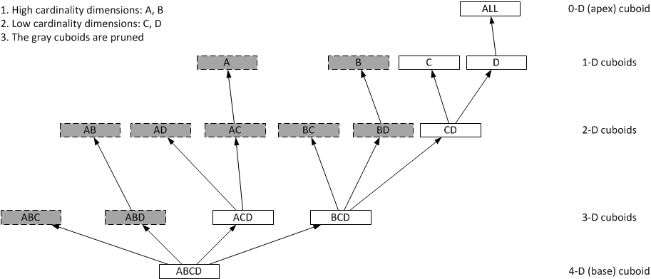
Partical Cube

Slide 28
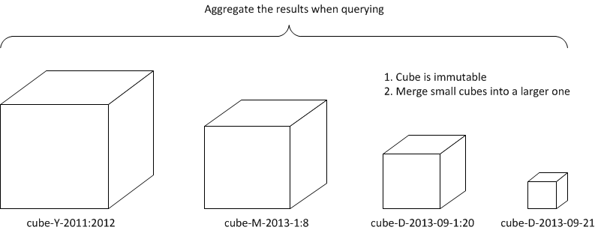
Incremental Build

Slide 29
What’s Next
Improve cube algorithm
Cube by segments, 30%-50% faster
Build delay down to tens of minutes
Streaming cubing
Analyze real-time data
Build delay down to seconds
Spark

Slide 30
Cube by Layer
The current algorithm
Many MRs, the number of dimensions
Huge shuffles, aggregation at reduce side, 100x of total cube size
0-D Cuboid
MR
1-D Cuboid
MR
2-D Cuboid
MR
3-D Cuboid
MR
4-D Cuboid
MR
Full Data

Slide 31
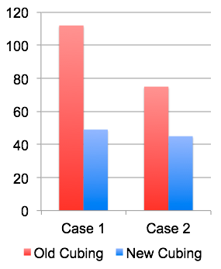
Cube by Segments
mapper
mapper
mapper
Data Split
Data Split
Data Split
……
Cube Segment
Cube Segment
Cube Segment
Merge Sort
(Shuffle)
Final Cube

Slide 32
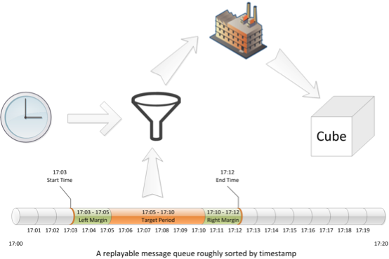
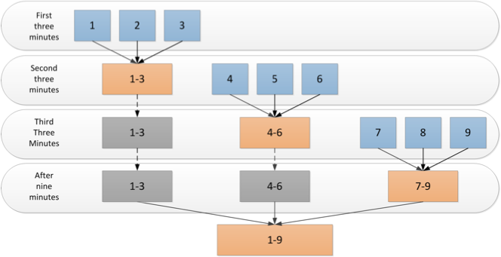
Streaming Cubing

Slide 33

Adding Spark Support
Cubing Efficiency - Spark Cubing Engine (Function Done)
MR is not optimal framework
Spark Cubing Engine
Source from SparkSQL
Read data from SparkSQL instead of Hive
Route to SparkSQL
Unsupported queries be coved by SparkSQL

Slide 34
Agenda
About Apache Kylin
Feature Highlights
Tech Highlights
Zeppelin Integration
Roadmap
Q&A

Slide 35
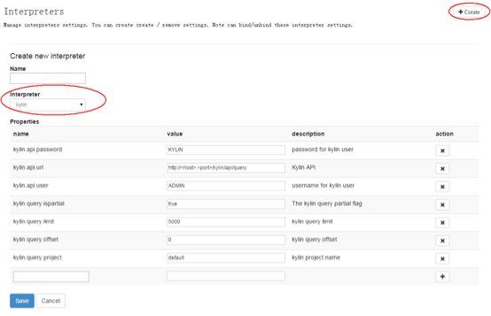
Create Kylin Interpreter
Pick up Kylin interpreter
Fulfils Kylin server information

Slide 36
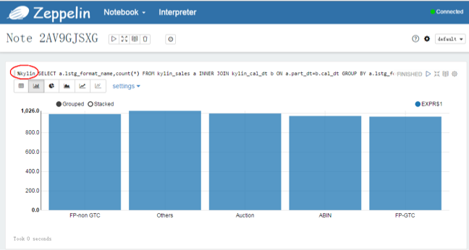
Visual Kylin Result
%kylin
ANSI SQL
d

Slide 37
Demo Video

Slide 38
Kylin Zeppelin Interpreter
executeQuer()
prepare HttpPost with SQL from UI
setup data (Project, Account, Password, etc.)
formatResult()
format Kylin query result to Zeppelin one (JSON tranform)

Slide 39
Agenda
About Apache Kylin
Feature Highlights
Tech Highlights
Zeppelin Integration
Roadmap
Q&A

Slide 40
Kylin Evolution Roadmap
2013
2014
2015
2016
Future
H1, 2015
TBD
Next Gen
Adv OLAP Functions
In-Memory Analysis (TBD)
Mobile (TBD)
… more
Oct, 2014
HybridOLAP
Lambda Arch
Automation
Capacity Management
Spark
… more
StreamingOLAP
Streaming OLAP
JDBC Driver
New UI
Excel
SparkSQL
… more
MOLAP
Incremental Refresh
ANSI SQL
ODBC Driver
Web GUI
Tableau
ACL
Open Source
Jan, 2014
Prototype for MOLAP
Basic end to end POC
Sep, 2013
Initial

Slide 41

Kylin Ecosystem
Kylin Core
Fundamental framework of Kylin OLAP Engine
Extension
Plugins to support for additional functions and features
Integration
Lifecycle Management Support to integrate with other applications
Interface
Allows for third party users to build more features via user-interface atop Kylin core
Integration
ODBC Driver
ETL
Drill
SparkSQL
Extension
Security
Redis Storage
Spark Engine
Docker
Kylin OLAP
Core
Interface
Web Console
Zeppelin Interpreter
Ambari/Hue Plugin

Slide 42

If you want to go fast, go alone.
If you want to go far, go together.
dev@kylin.incubator.apache.org
--African Proverb

